Slide 1
Εφαρμογή DCCA στο ADNI
Γιώργος Αϊδίνης

Slide 2
Understanding the method
Study our Dataset
Perform Linear Regression, keep residuals to remove any unwanted effect
Train DCCA Network
Transform features through DCCA NN
Perform Classification using various algorithms
Conclusions

Slide 3
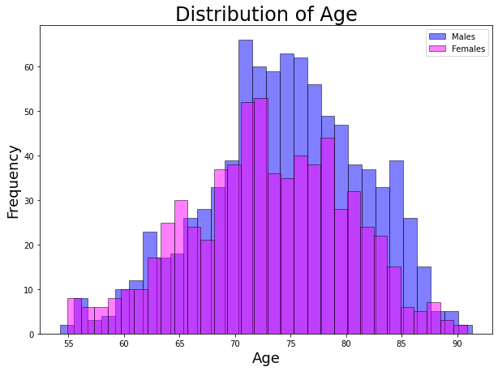
The ADNI Dataset (1)

Slide 4
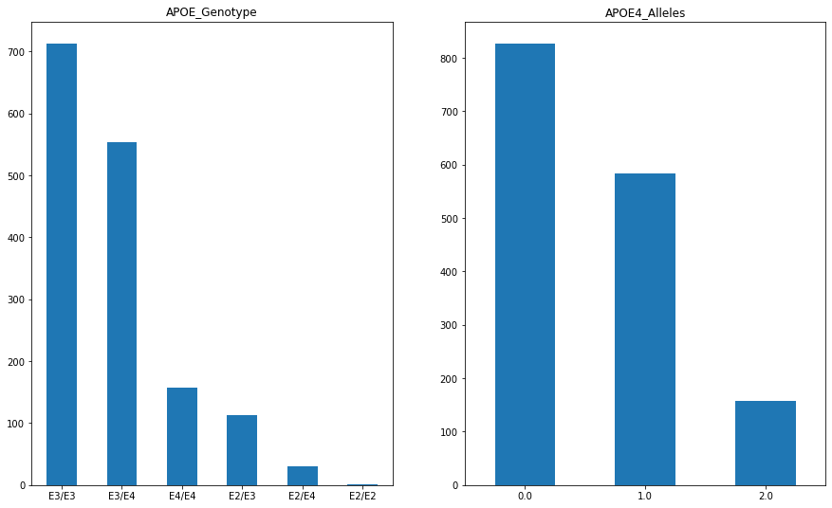
The ADNI Dataset (2)

Slide 5
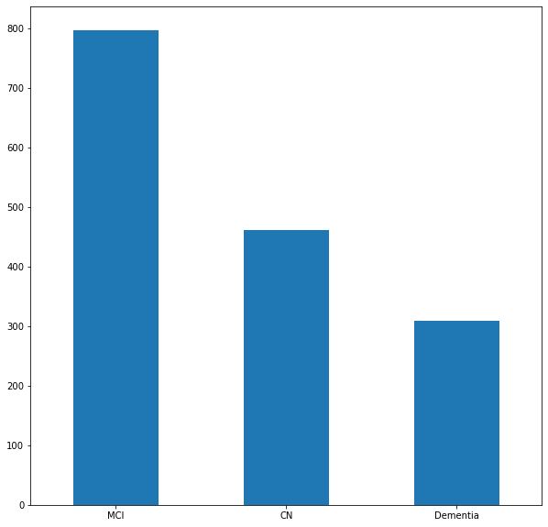
The ADNI Dataset (3)

Slide 6
Performing Linear Regression to remove Age, Sex, Brain Size effect
Age group chosen: 65-85
Fit to Cognitive Normals
Transform everyone in age group (CN, MCI, Dementia)

Slide 7
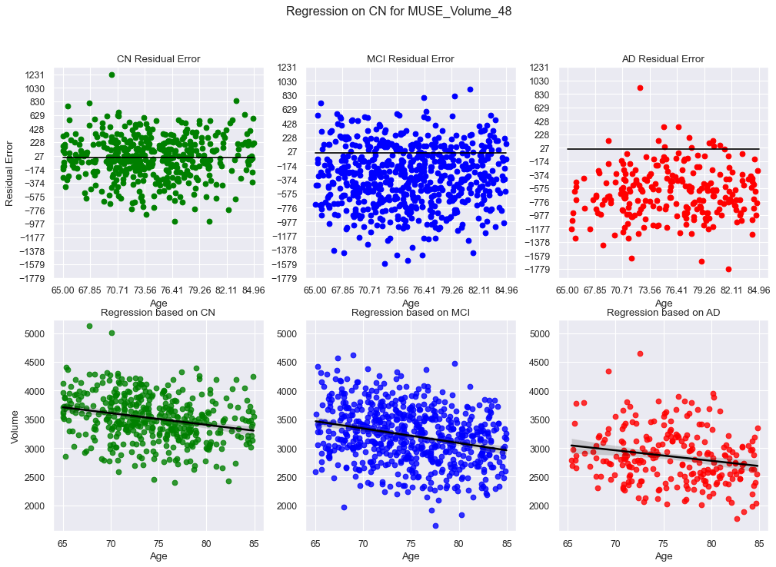
Linear Regression (1)

Slide 8
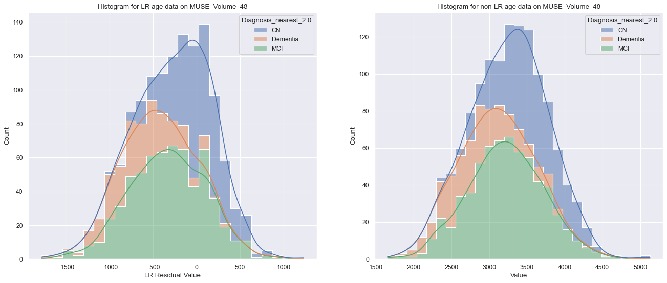
Linear Regression (2)

Slide 9
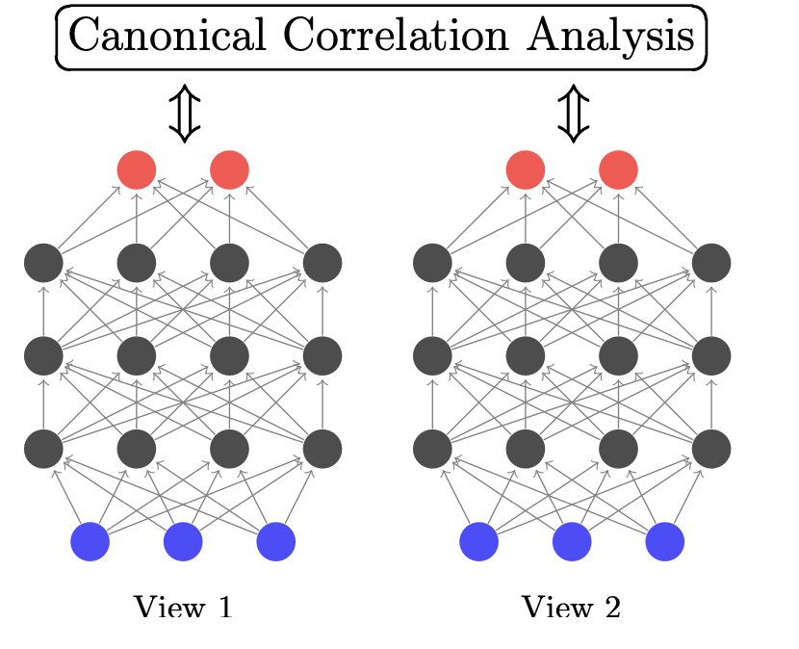
Using DCCA
2 Views:
Imaging Data
Genetic Data
Play with parameters: (Use GridSearchCV)
Output layer dimensions
Number of Hidden Layers
Hidden Layer Size
Regularization
Learning Rate
Batching

Slide 10
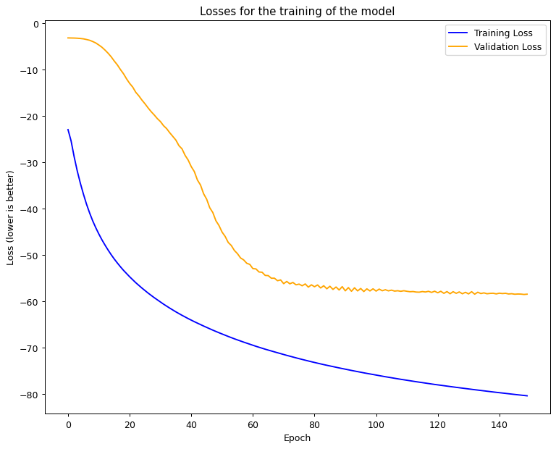
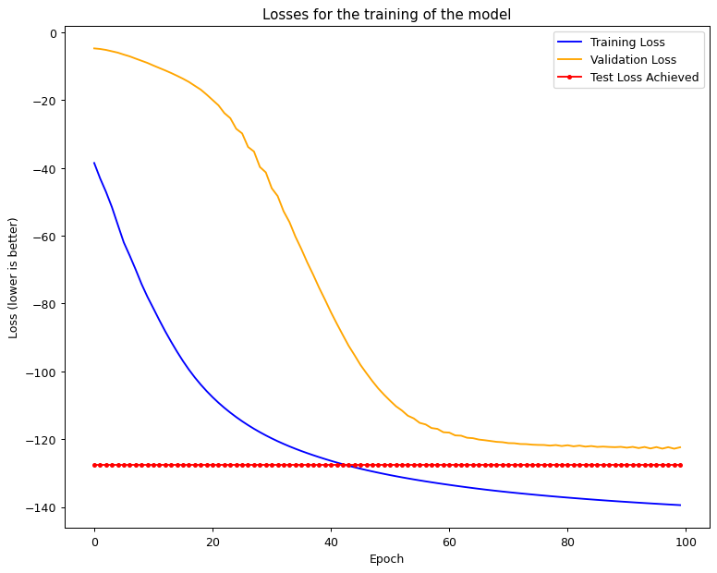
Performing DCCA (1)

Slide 11
Performing DCCA (2)
CCA on DCCA NN input data:
Correlation = -1.225
CCA on DCCA NN output data:
Correlation = 0.139
Higher is better
1 is max (perfectly linearly correlated)
Can be negative (arbitrarily bad)

Slide 12
Performing DCCA (3)
The 2 Views are:
Genetic Data in the form of 54 SNPs
Imaging Data in the form of 145 ROIs
Use raw 145 ROI format
Apply OPNMF and reduce to 30

Slide 13
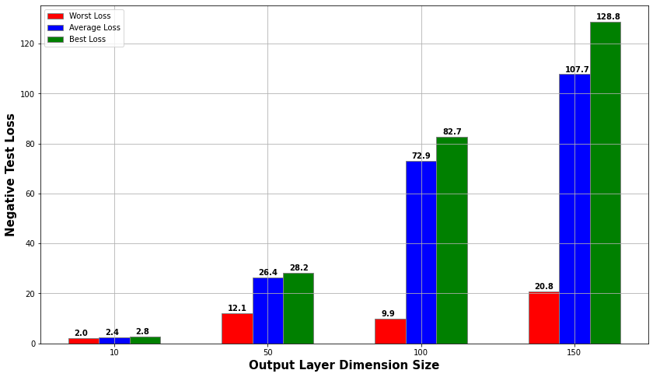
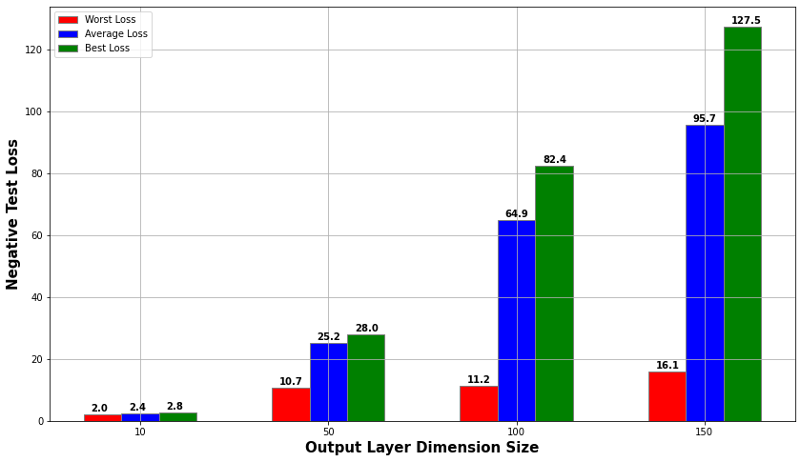
Analysing the DCCA Results (1)
145 ROI vs 30 through OPNMF based on Output Layer Size

Slide 14
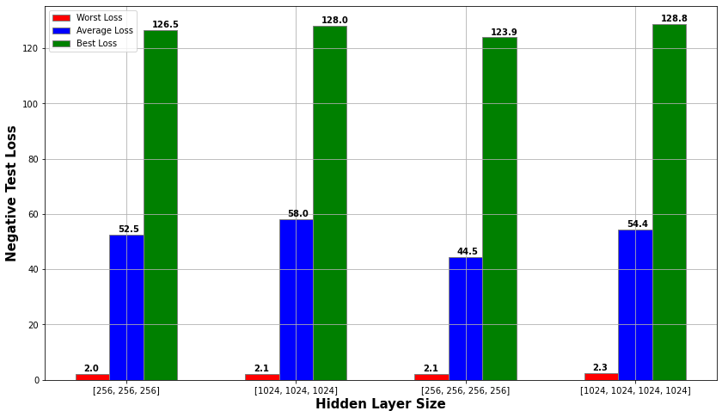
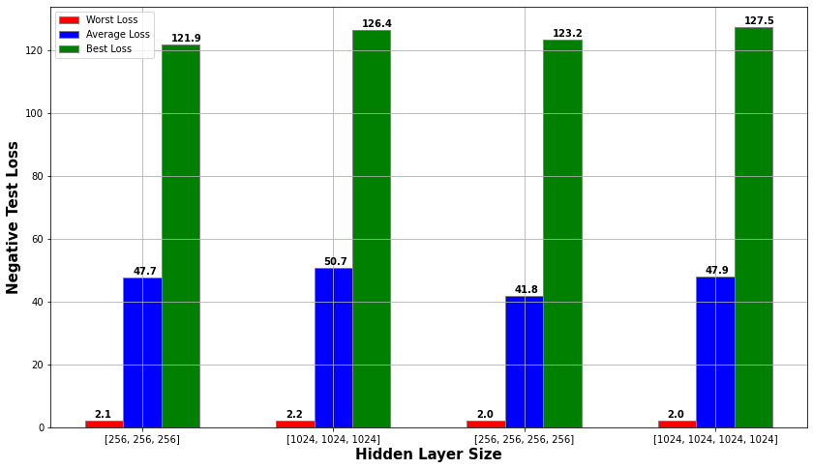
Analysing the DCCA Results (2)
145 ROI vs 30 through OPNMF based on Hidden Layers

Slide 15
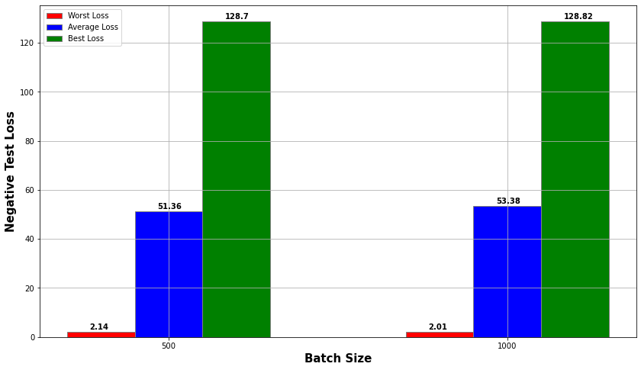
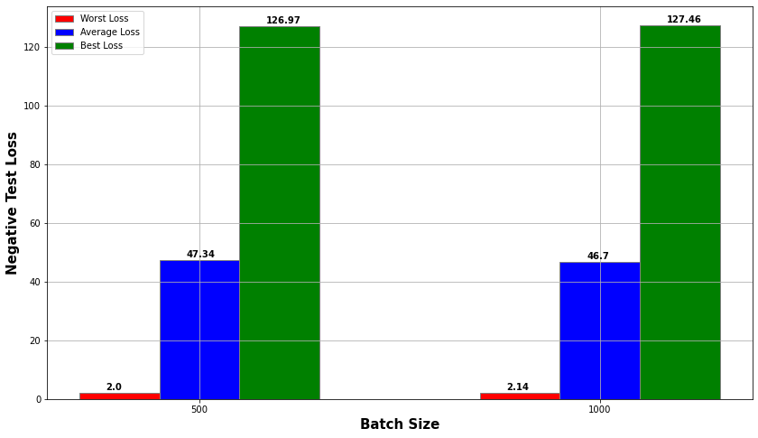
Analysing the DCCA Results (3)
145 ROI vs 30 through OPNMF based on Batch Size

Slide 16
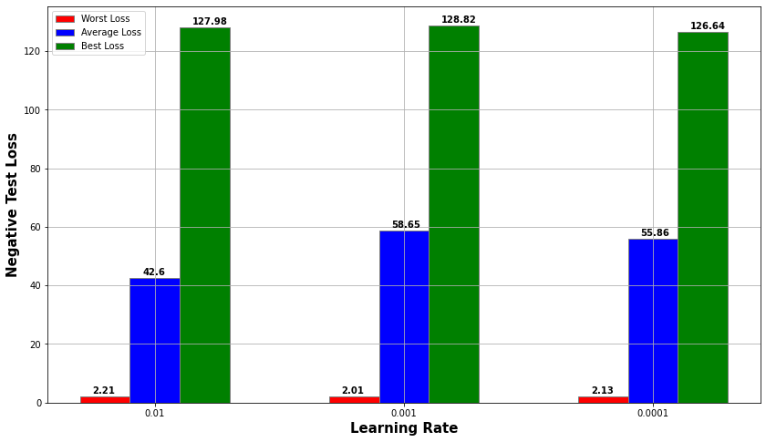
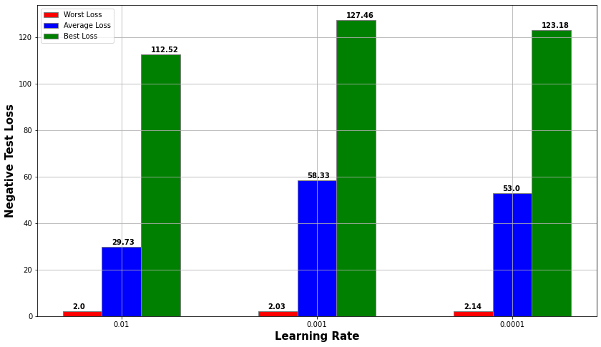
Analysing the DCCA Results (4)
145 ROI vs 30 through OPNMF based on Learning Rate

Slide 17
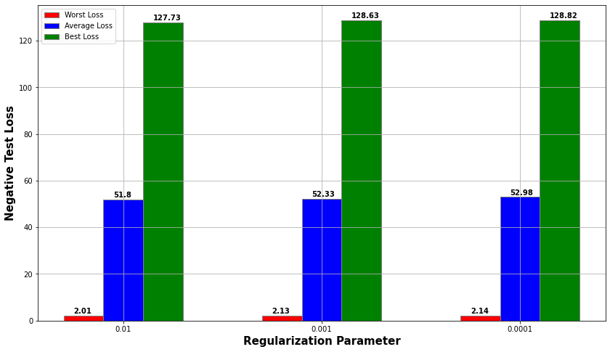
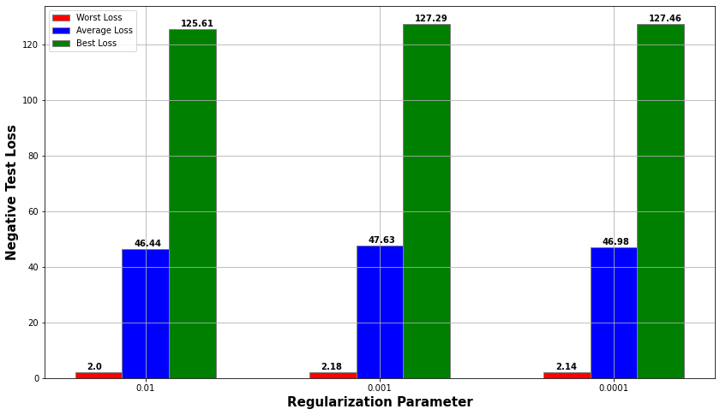
Analysing the DCCA Results (5)
145 ROI vs 30 through OPNMF based on Batch Size

Slide 18
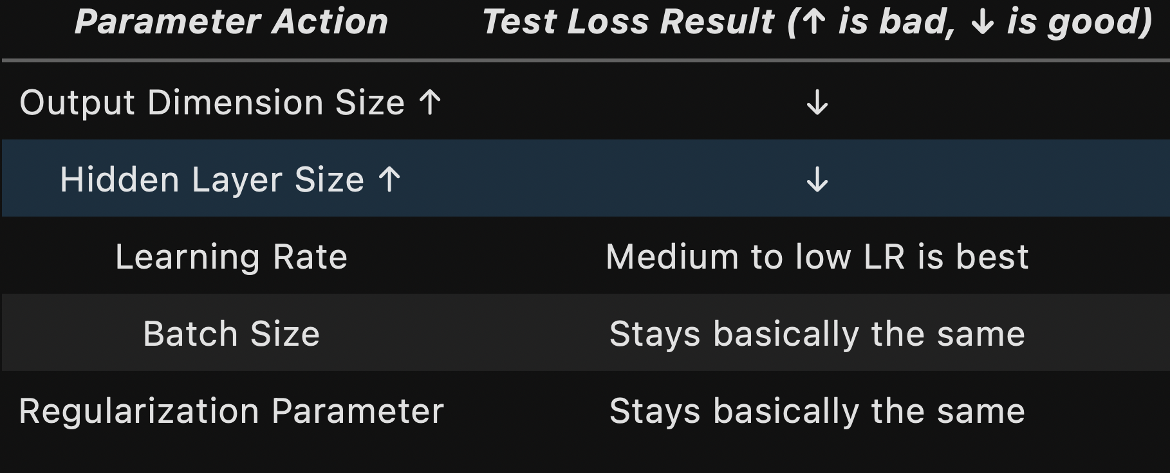
DCCA Conclusions

Slide 19
Classification using SVM
Play around with:
Kernel (Linear, Poly, RBF)
Iterations
Coefficients and gamma params
Regularisation
Use GridSearch
Use Cross Validation (5 Folds)

Slide 20
Initial DCCA, no OPNMF

Slide 21
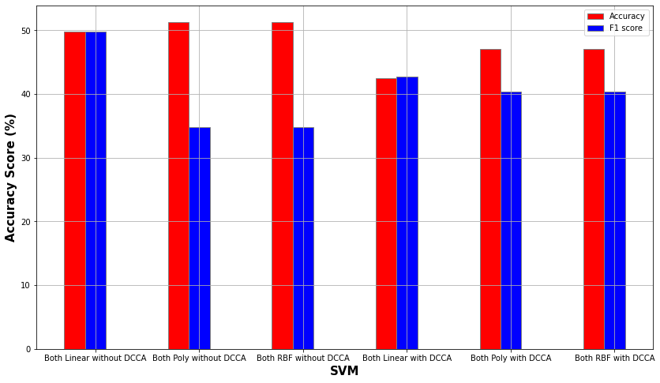
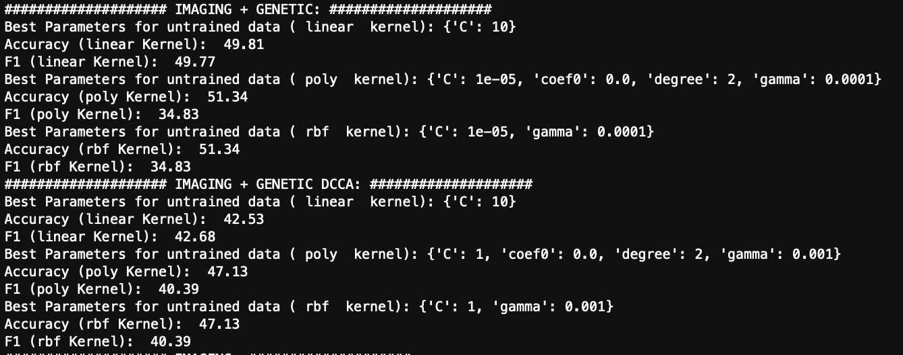
Classification using initial DCCA (1)
Accuracy: 51.34%

Slide 22
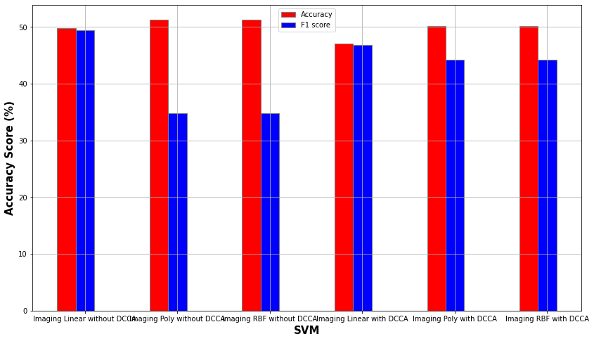
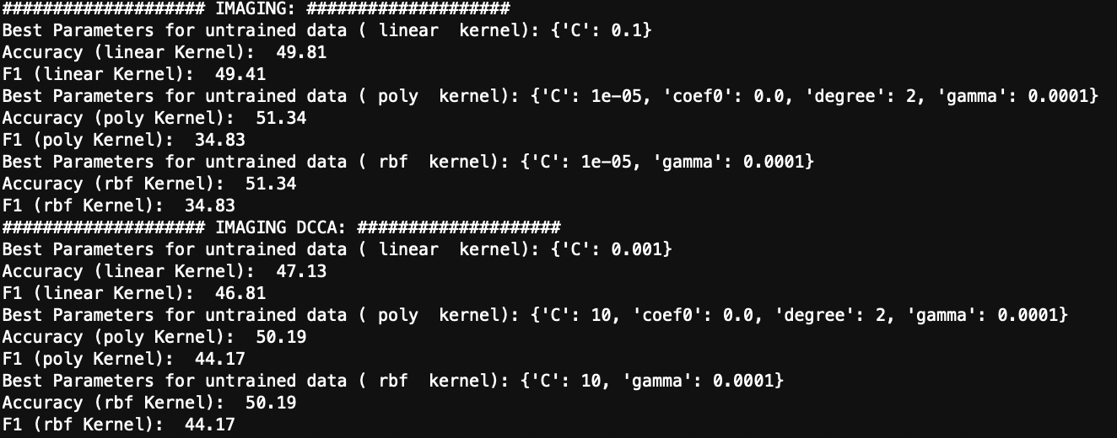
Classification using initial DCCA (2)
Accuracy: 51.34%

Slide 23
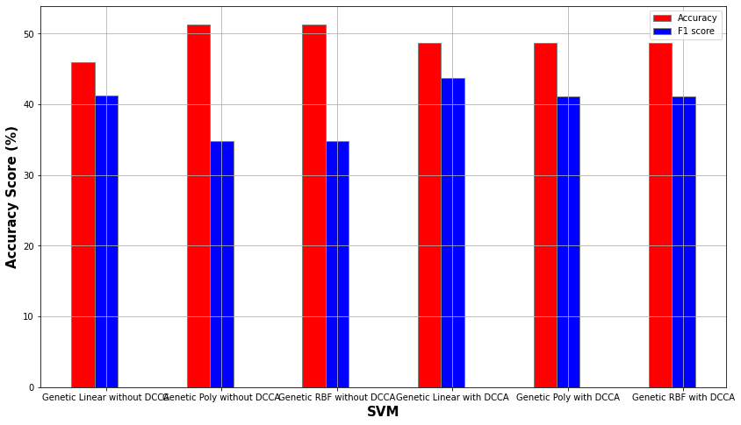
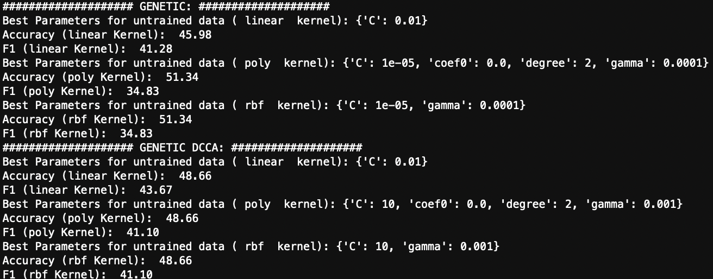
Classification using initial DCCA (3)
Accuracy: 51.34%

Slide 24
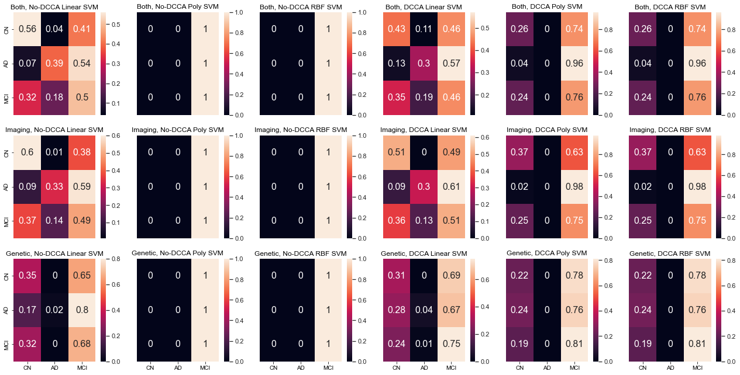
Classification using initial DCCA (4)

Slide 25
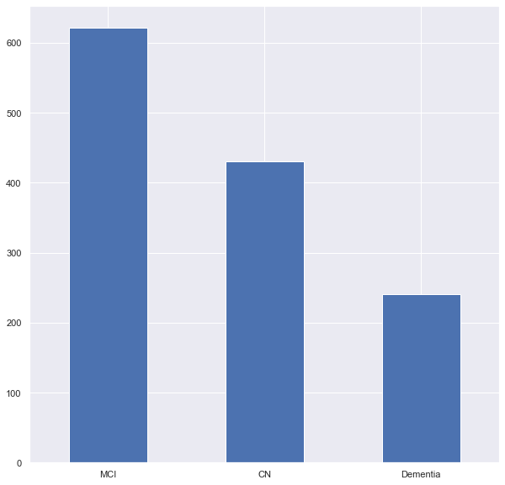
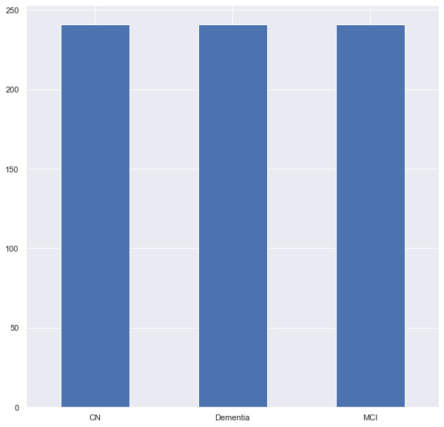
Using Sampling and Balancing (1)
Use random UnderSampling
Use Standard Scaling (not on Genetic data)

Slide 26
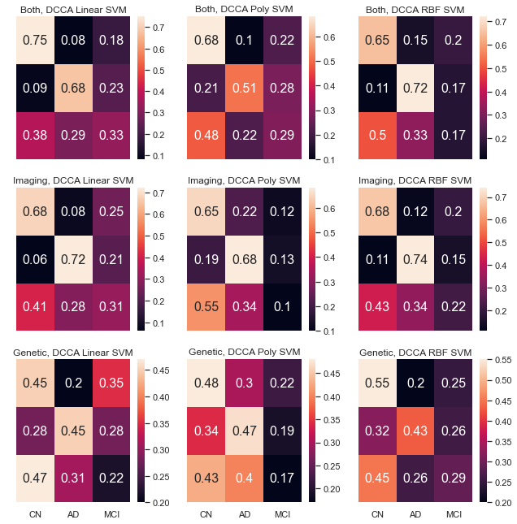
Using Sampling and Balancing (2)
Model with max Accuracy: Imaging Linear No DCCA (Accuracy = 56.452 )
Model with max F1: Imaging Linear with DCCA (F1 Score = 55.893)
Better results than before
Better without DCCA than with!
Imaging is better than both?

Slide 27
Use OPNMF

Slide 28
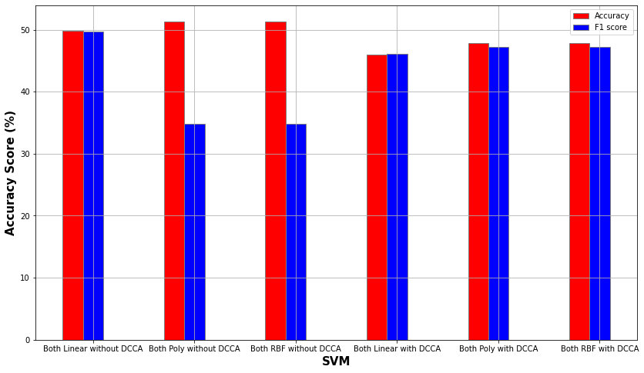
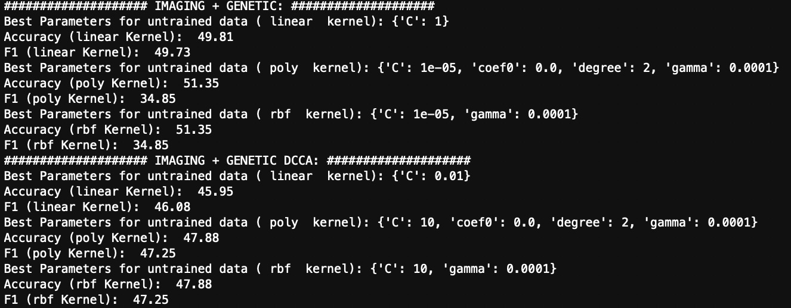
Classification using OPNMF DCCA (1)
Accuracy: 51.35%

Slide 29
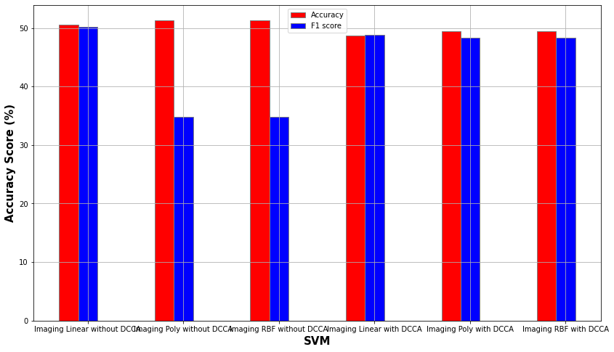
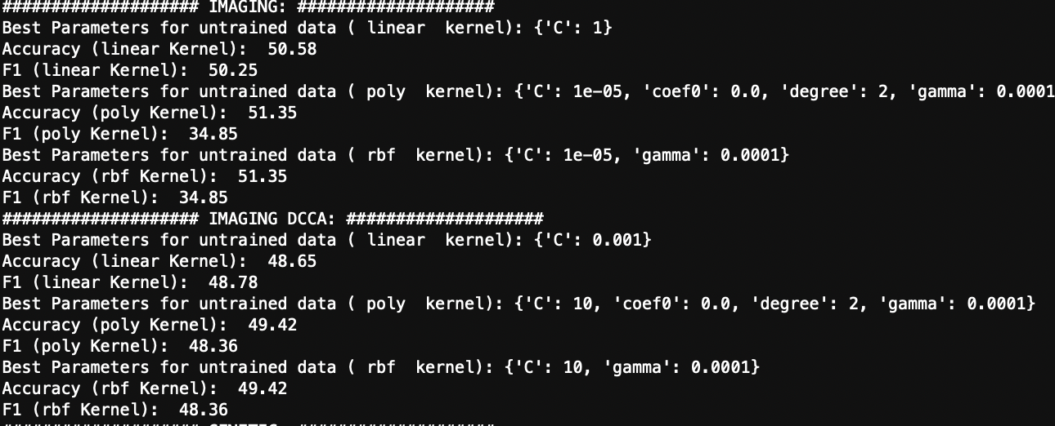
Classification using OPNMF DCCA (2)
Accuracy: 51.35%

Slide 30
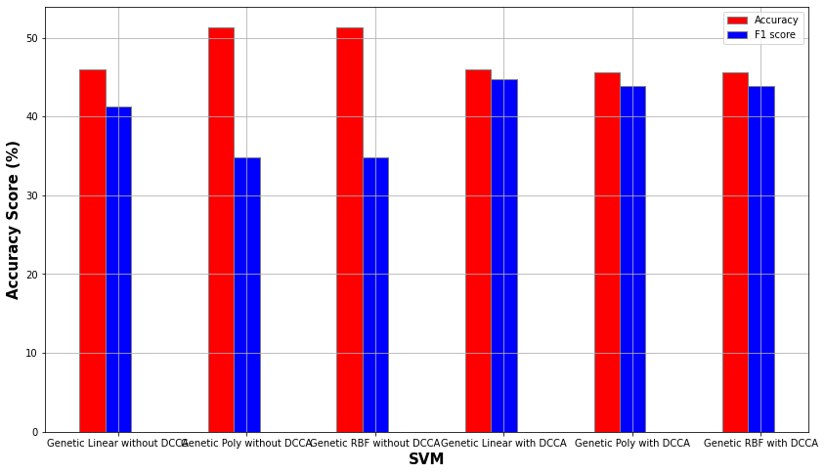
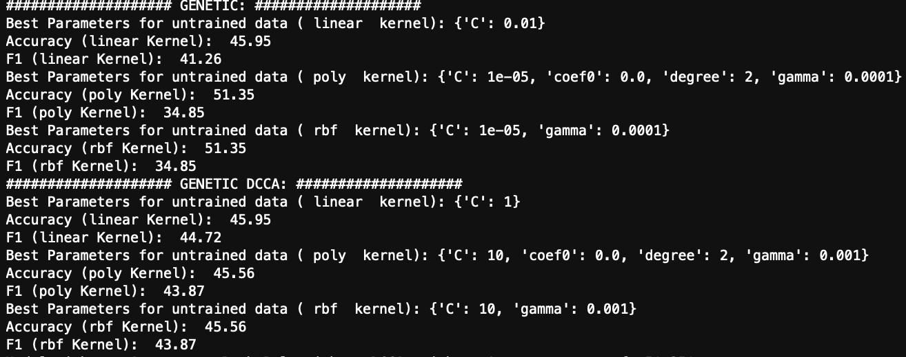
Classification using OPNMF DCCA (3)
Accuracy: 51.35%

Slide 31
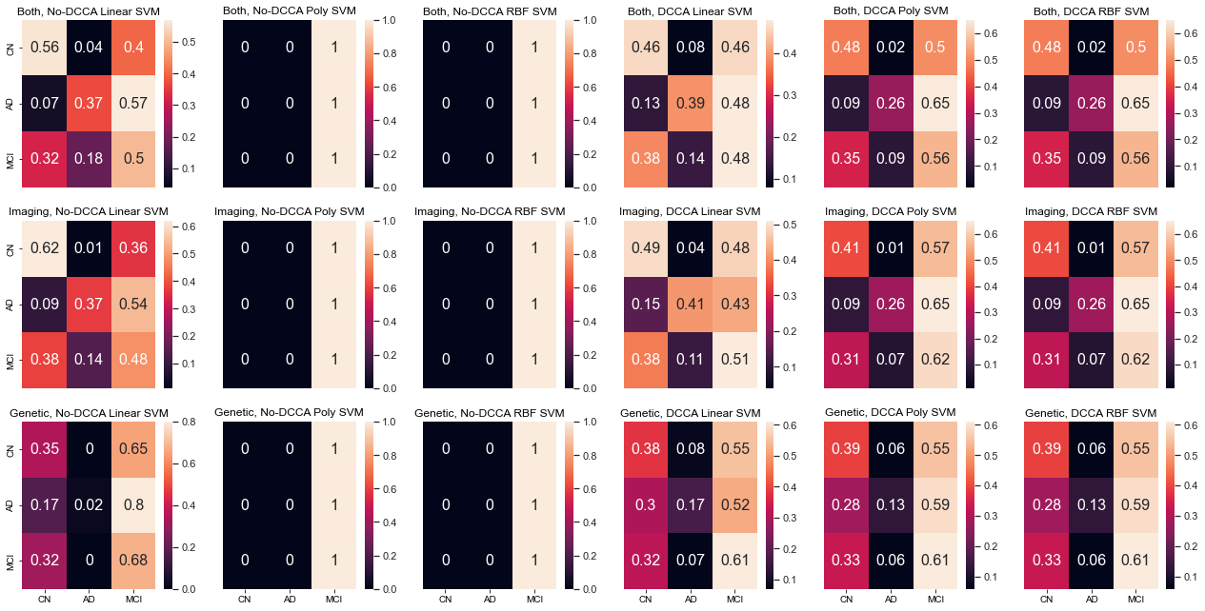
Classification using OPNMF DCCA (4)

Slide 32
Using Sampling and Balancing (1)
Use random UnderSampling
Use Standard Scaling (not on Genetic data)

Slide 33
Using Sampling and Balancing (2)
Model with max Accuracy: Both Linear with DCCA (Accuracy = 55.862 )
Model with max F1: Both Linear with DCCA (F1 Score = 54.196)
Better results than before
Better with DCCA than without!

Slide 34
Conclusions
DCCA has more robust results (better F1 Score)
DCCA has worse accuracy than no-DCCA
Imaging with Linear SVM, no DCCA, no OPNMF is best
2nd best is Both, Linear SVM, DCCA, OPNMF
Scaling is needed for 145 ROIs, not for OPNMF reduced
Undersampling helps

